Slide 1


Custom network scanner
Ziyad al gebri, tymon schuringa

Slide 2
assessment
Build network scanner
Why is it useful?

Slide 3
requirements
➢ Host Discovery
➢ Port Scanning
➢ Application & Version Detection
➢ OS Detection

Slide 4
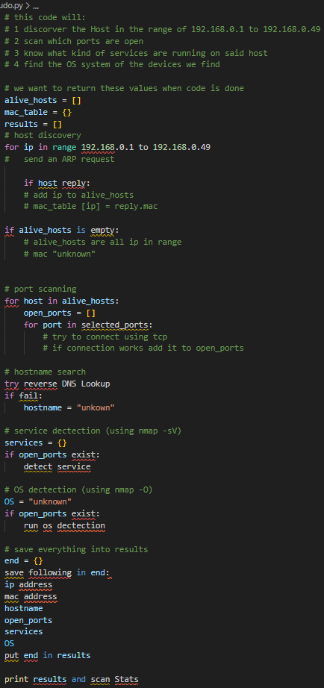
progression
Code design: which functions do we need?
Pseudo code

Slide 5
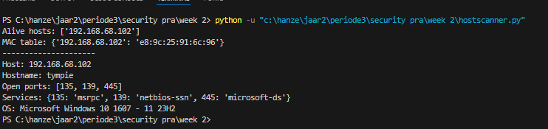
Results tested from home:

Slide 6
Improvements
Use colorama for improvement of readability
write proper docstrings
Progress reports during the scan
Allow user to control scan options in command line. (Including scanning different subnets)
Write the rapport

Slide 7
conclusion
There has been solid progress on the design
We build a strong foundation of the functionality
Clear vison for completion of assessment

